Slide 1



Introduction to Serverless Computing
Serverless computing is a cloud-based execution model that allows developers to build and run applications without the need to manage servers. Instead, the cloud provider handles the provisioning, scaling, and management of the underlying infrastructure, enabling developers to focus solely on writing and deploying their application code.
by kamalini
sr

Slide 2
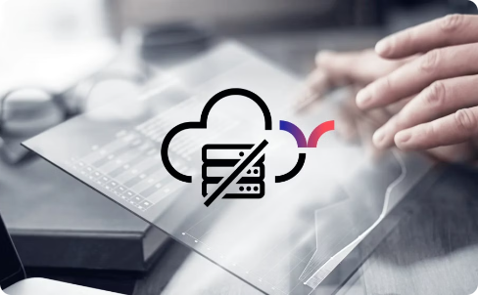
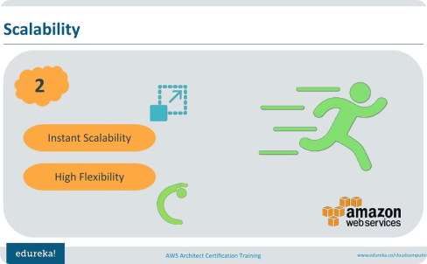

Benefits of Serverless Architecture
Reduced Infrastructure Management
Automatic Scalability
Cost Optimization
Serverless platforms automatically scale resources up and down based on demand, ensuring your application can handle spikes in traffic without manual intervention.
Serverless architectures follow a pay-per-use model, where you only pay for the resources your application consumes, resulting in significant cost savings compared to traditional server-based deployments.
Serverless computing eliminates the need to provision, maintain, and scale servers, allowing developers to focus solely on writing and deploying their application code.

Slide 3
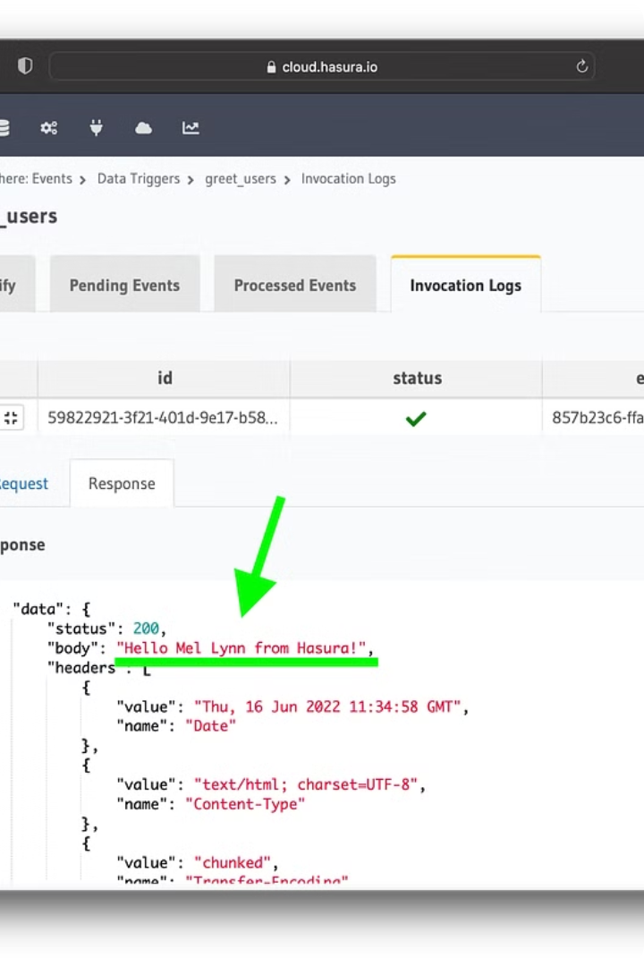
Serverless Functions and Event-Driven Triggers
Serverless functions, powered by event-driven triggers, are the building blocks of serverless architectures. These functions execute in response to specific events, such as an HTTP request, database update, or message queue notification, without the need to manage underlying servers.
By leveraging event-driven triggers, developers can create highly scalable, event-reactive applications that automatically scale up and down based on demand, ensuring optimal performance and cost-efficiency.

Slide 4
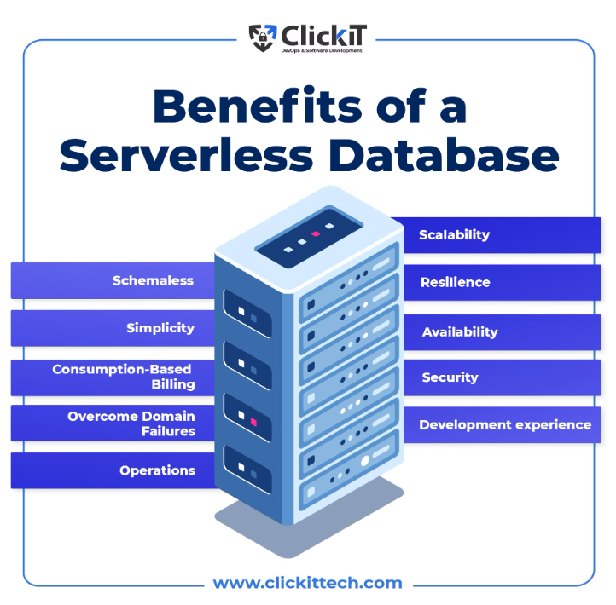
Serverless Databases and Storage Solutions
Serverless platforms offer highly scalable and cost-effective database and storage solutions, allowing you to focus on building your application rather than managing the underlying infrastructure.
Serverless databases like Amazon DynamoDB and Google Firestore automatically scale up and down based on demand, ensuring your data is always available without the need for manual provisioning or scaling.
Serverless storage solutions like Amazon S3 and Google Cloud Storage provide virtually unlimited capacity and durability, making them ideal for storing application assets, user-generated content, and large datasets.

Slide 5
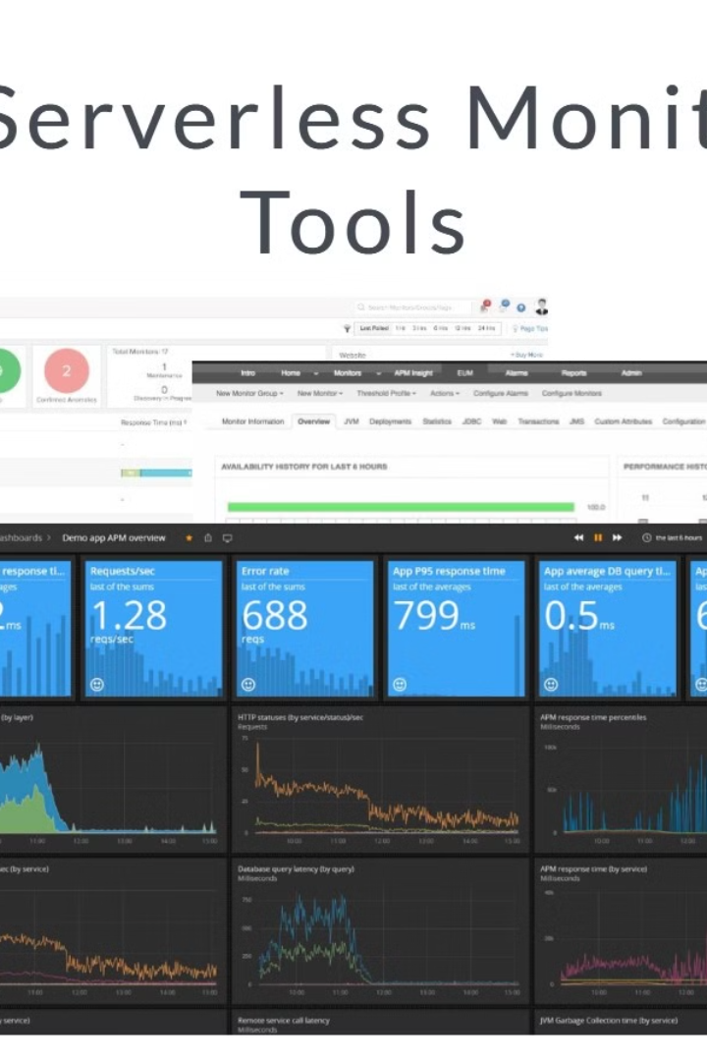
Serverless Monitoring and Logging
Serverless architectures require robust monitoring and logging solutions to ensure visibility and control over your applications. Serverless platforms integrate with powerful monitoring services that track key metrics, errors, and performance data, providing deep insights into the health and behavior of your serverless functions.
Comprehensive logging capabilities enable you to troubleshoot issues, analyze user activity, and monitor the overall performance of your serverless environment. These logs can be seamlessly integrated with centralized logging platforms for end-to-end visibility across your entire infrastructure.

Slide 6

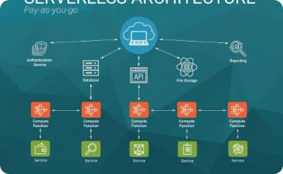
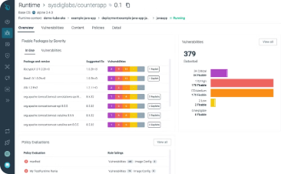
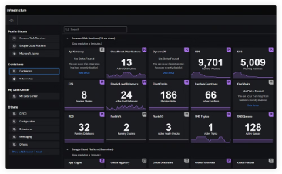
Serverless Security Considerations
Identity and Access Management
Data Encryption
Vulnerability Scanning
Logging and Monitoring
Encrypt data at rest and in transit to protect sensitive information from unauthorized access and comply with industry regulations.
Regularly scan your serverless functions and dependencies for known vulnerabilities to quickly identify and address potential security risks.
Implement robust identity and access controls to ensure only authorized users and services can interact with your serverless functions and resources.
Leverage comprehensive logging and monitoring solutions to detect and respond to suspicious activities, security incidents, and compliance issues.

Slide 7
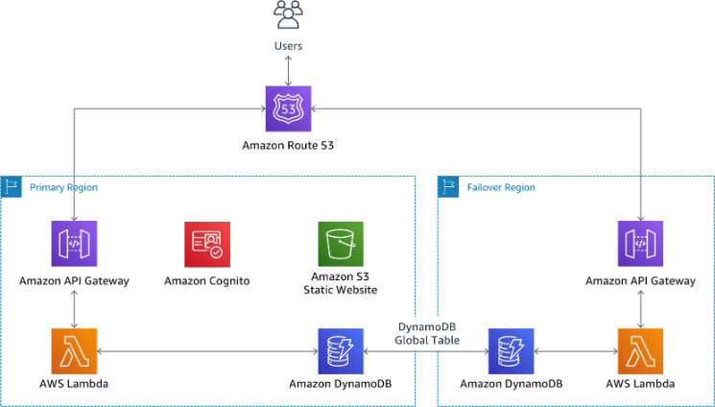
Serverless Scalability and Availability
Serverless architectures inherently provide exceptional scalability and availability to handle fluctuating user demands and traffic spikes without manual intervention.
Serverless functions automatically scale up or down based on the incoming event load, ensuring your application can handle increased workloads seamlessly. This elasticity allows you to avoid over-provisioning resources during low usage periods.
Serverless platforms also offer built-in high availability features, such as automatic replication and failover, ensuring your application remains accessible and responsive even in the face of infrastructure failures or regional outages.

Slide 8
Serverless Cost Optimization Strategies
Right-size Functions
Leverage Caching
Carefully configure the memory, CPU, and timeout settings of your serverless functions to match your workload requirements, avoiding over-provisioning and unnecessary costs.
Implement caching mechanisms to reduce the number of invocations and minimize the cost of frequently accessed data or compute-intensive operations.
Optimize Data Storage
Implement Autoscaling
Choose the most cost-effective serverless data storage solutions, such as DynamoDB or Firestore, and use appropriate data modeling to minimize read/write operations.
Configure your serverless functions to automatically scale up and down based on demand, ensuring you only pay for the resources you need.

Slide 9




Serverless Deployment and CI/CD Pipelines
CI/CD Automation
Leverage serverless CI/CD tools like AWS CodePipeline and Azure DevOps to automate your build, test, and deployment processes, ensuring consistent and reliable releases.
Infrastructure as Code
Define your serverless infrastructure, including functions, databases, and storage, using Infrastructure as Code (IaC) tools like AWS CloudFormation and Terraform. This enables version control, collaboration, and seamless deployments.
Continuous Deployment
Configure your CI/CD pipeline to automatically deploy updates to your serverless functions and resources, minimizing manual intervention and accelerating the delivery of new features and bug fixes.
Canary Deployments
Implement canary deployments to gradually roll out changes to a subset of your user base, allowing you to test and monitor the impact before a full production release.

Slide 10

Conclusion and Future Trends in Serverless
As serverless computing continues to evolve, organizations can expect even greater advancements in scalability, cost-efficiency, and developer productivity. Emerging trends like serverless containers, edge computing, and AI-powered functions will further revolutionize the way we build and deploy applications in the cloud.

